Slide 1
Environmental Monitoring
NOISE POLLUTION MONITORING IN PARK

Slide 2
Abstract
The noise pollution poses a high environmental risk to human health, both direct and indirect, and it can be defined as unwanted or harmful outdoor sound.
The purpose of this paper is hardware and software implementation of a noise measurement and monitoring system.
The system contains a sound sensor (microphone), computer for processing and sampling the sound, calculating frequency and power of the sound and for communication with a server, server for storing the data computed from the measurement.

Slide 3
Tools And Technologies
HARDWARE TECHNOLOGIES
→ Sound Sensor
→Wi-Fi Modem
→LCD Display
→Crystal Oscillator
→Resistors
→Capacitors
→Diodes
→Breadboard
→Push Button
→Transformer
→Mics
SOFTWARE TECHNOLIGIES
→IOT Gecko
→Programming Language

Slide 4


Slide 5


Slide 6
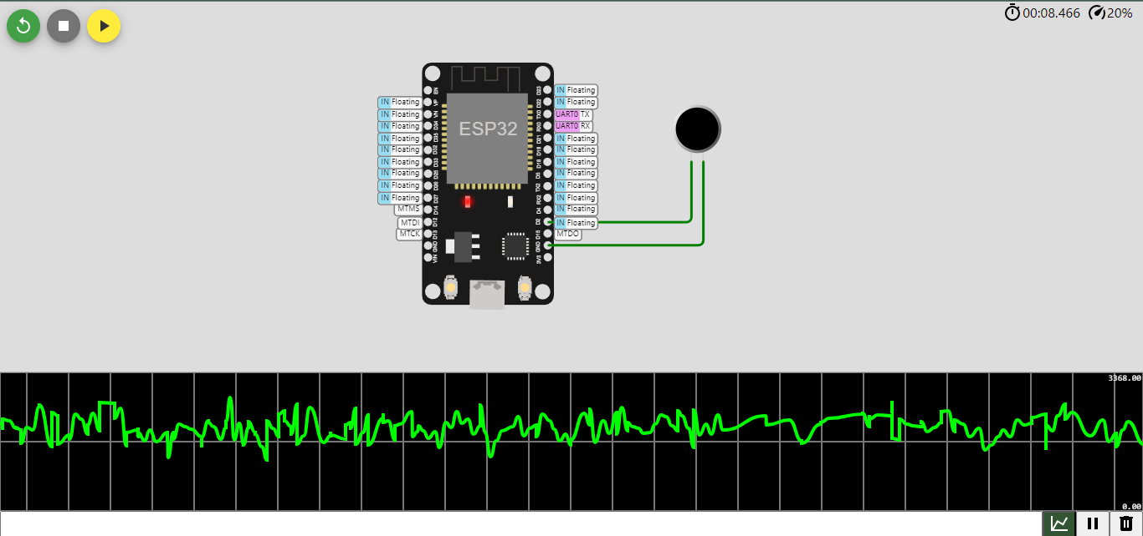

Slide 7
Challenges of Noise Pollution
Diverse Noise Sources: Parks can be exposed to a wide range of noise sources, including road traffic, nearby industrial facilities, construction activities, and recreational events. Managing and monitoring all these sources can be complex.
Seasonal and Event-Based Variation: Noise levels in parks can vary significantly based on seasons, events, and times of the day. For example, summer festivals or holiday events can lead to spikes in noise levels.
Community Expectations: Balancing the need to reduce noise pollution with the expectations of park visitors and local communities can be challenging. Some noise is inherent to recreational activities and social interactions in parks.
Enforcement and Regulation: Enforcing noise regulations in park areas may require coordination with local authorities and law enforcement agencies. Ensuring that noise regulations are adhered to can be difficult.

Slide 8
Limitations of Noise Pollution
Influence of Natural Sounds: Parks are valued for their natural soundscapes, including birdsong and flowing water. Noise monitoring systems may not distinguish between desirable natural sounds and undesirable noise pollution.
Noise Propagation: The way noise travels can be affected by topography, vegetation, and other environmental factors. Predicting how noise propagates within a park can be complex.
Resource Limitations: Park management agencies may have limited resources to address noise pollution. This can result in delays in implementing mitigation measures.
Visitor Education: While noise mitigation efforts can be implemented, they may not always succeed in reducing noise pollution if park visitors are not aware of the importance of maintaining a quieter environment.

Slide 9
Conclusion
The implementation of effective noise monitoring systems and the collection of data are essential steps in understanding and managing noise pollution in park areas.
Such monitoring systems enable park management agencies to make informed decisions and implement targeted mitigation strategies.
By fostering a greater understanding of the impact of noise pollution on the overall park experience and the natural environment, we can work together to create more serene and enjoyable park spaces that benefit both people and the ecosystems within these valuable urban oases.
This, in turn, contributes to the well-being and happiness of our communities and the preservation of our natural world for generations to come.

Slide 10


